Slide 1
Case Study on application BookMyShow using AWS EC2
By
Bharath Kumar Natesan Arumugam
Sibi Chakravarthy Ramesh

Slide 2
AWS EC2
Cloud Computing : on-demand delivery of compute power, database storage, applications and other IT resources.
AWS : Offers a suite of cloud computing services that make up on-demand computing platform.
EC2 : Web Service that provides resizable compute capacity in the cloud.
Makes Web Scale Cloud Computing easier for developers.
Provides complete control of computing resources and run’s on Amazon’s proven computing environment.

Slide 3
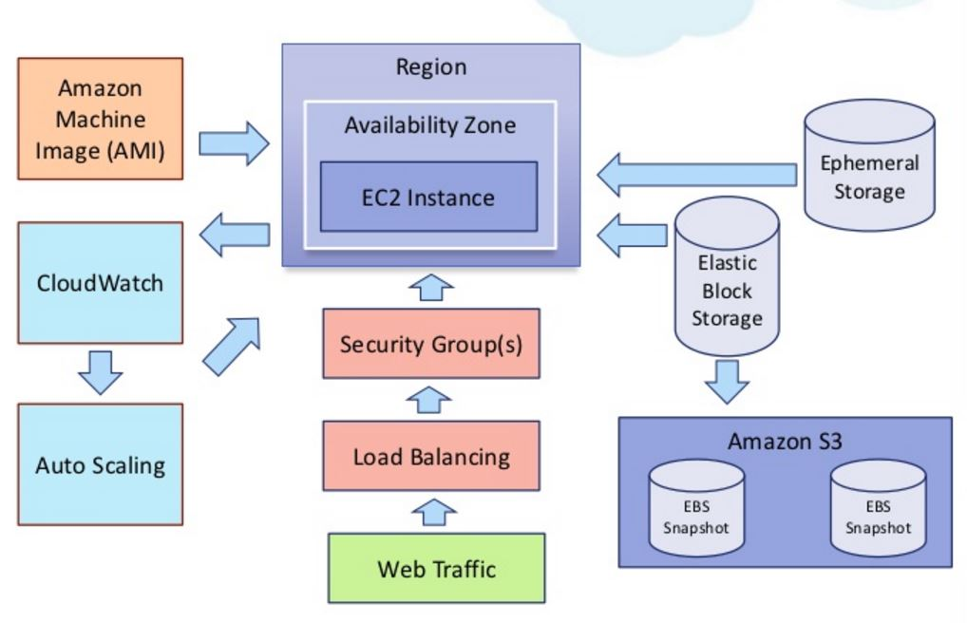
AWS EC2 - Architecture

Slide 4
AWS EC2 - Components
EC2 Instance
Amazon Machine Image (AMI)
Elastic Block Storage(EBS)
Amazon Simple Storage Service (S3)

Slide 5
AWS EC2 - Instance
Uses Xen Virtualization.
Each VM’s called as “Instance”
Scales Instances based on “Elastic Compute Units”
Types :
On-Demand
Reserved
Spot

Slide 6
AWS EC2 - AMI
Special type of virtual appliance used to create virtual machine
Contents:
Read-Only File System
Compressed AMI file system
XML Manifest File
Pointer to the kernel ID
Operating Systems
Linux
Windows Server 2003,2008 and 2012
FreeBSD
NetBSD

Slide 7
AWS EC2 - EBS
Provides Block-Level Storage that can be attached to Amazon EC2 instances.
Format and mount as a File System or access directly
High Performance, availability and persistent
Supports Snapshots and Cloning
Upto 1TB
Replicated Storage – No Data Loss

Slide 8
AWS EC2 – S3
Provides Storage through web service interfaces
$0.15/GB and Discounts for valuable Customers
Provides Scalability, High Availability, Low Latency and High Durability at commodity costs
Claimed to provide 99.999999999% durability and 99.99% availability but no SLA for durability
Can host Entire Website
Logs stored in S3 Buckets

Slide 9
AWS CloudWatch
Real-time monitoring of EC2 Customers on their usage of CPU, Disk and network
Additional Software to show memory, disk space or load average metrics
Can be accessed through CLI’s and Web API’s
Has Auto-Scaling feature to dynamically add or remove EC2 instances
Customers are charged for each monitoring instances

Slide 10
AWS Automated Scaling
Allows to automatically adapt computing capacity to site traffic
Types:
Rule-Based
Schedule Based
Not suitable for time critical applications
VM startup time is dependent on image size, VM type, data center locations etc.

Slide 11
AWS EC2 - Security
Access key and secret key to authenticate when accessing AWS API’s
Public key and private key to authenticate when accessing EC2 instance

Slide 12
BookMyshow
Largest entertainment-ticketing portal in India - 400 million average page views a month.
Launched in 2007 with headquarters in Mumbai and owns 85-90% of the online entertainment ticketing market.
Portal contains information about upcoming movies and events, show times, venue details, and artist bios.
A team of more than 100 engineers spread across three locations to monitor and upgrade the site.

Slide 13
Challenges
Maintain performance during high profile events such as the release of blockbuster movies.
Ensure zero downtime for the online ticket ordering application amidst increased demand.
Provide a solution that could be rapidly deployed without disrupting service and with little or no change to BookMyShow’s existing infrastructure and application.
Servers are segmented into several zones, including servers for customer data and credit card information, database servers, and web application servers. In this complicated environment, maintaining firewall rules manually was a challenging task.

Slide 14
Using multiple open source tools, each with its own management console, for monitoring files and logs.
Combatted low-profile hacks with a variety of tools and techniques, but found it a challenge to cope with bigger, more sophisticated attacks.

Slide 15
Solution
BookMyShow is exploring Platform as a Service options that would allow them to scale up for weeks or days when popular movie launches or sporting events cause a spike in website traffic.
Tight integration with leading cloud service providers such as Amazon Web Services (AWS) and Microsoft Azure make deployment fast and easy.
Benefits
Zero Downtime
Better Performance
Scalability

Slide 16
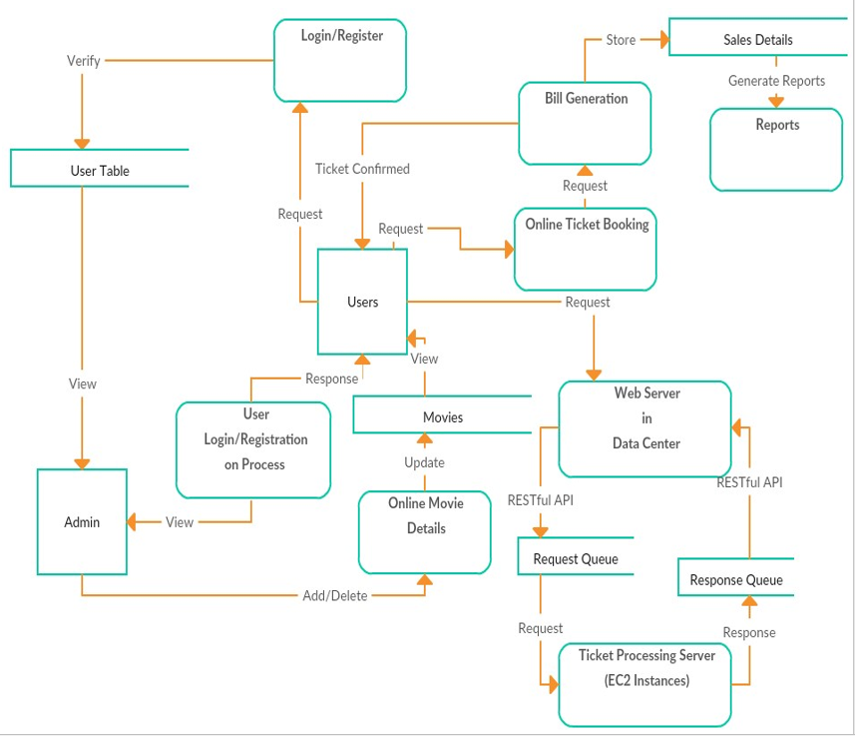
Data Flow Diagram

Slide 17
Flexible
How? Using Amazon EC2
Available in different locations.
Extensive list of supported operating systems & software.
Easily Integrate with other AWS service.
Purchasing options for cost optimization.
Import and Export virtual machines.
Choice of instance families with differing resource ratios.

Slide 18
Available
How? Using Amazon EBS and Amazon S3
EBS volumes are automatically replicated within the Availability Zone (AZ) in which they are created.
Can be shared across AWS accounts or copied across AWS regions
Data stored at rest on the volume, disk I/O, and snapshots created from the volume are all encrypted .

Slide 19
Scalable
How? Using Auto Scaling and Load Balancer
Amazon EC2 reduces the time required to obtain and boot new server instances to minutes, allowing you to quickly scale capacity, both up and down, as your computing requirements change.
Auto Scaling automatically increase the number of Amazon EC2 instances during demand spikes to maintain performance and decrease capacity during lulls to reduce costs.
Elastic Load Balancing helps to distribute traffic to your instances within Auto Scaling groups.

Slide 20
Secure
How? Using Amazon Virtual Private Cloud
Compute instances are located in a VPC within an IP within a given IP range.
Decide which instances are exposed to the Internet and which remain private.
Access key and secret key used to authenticate when accessing AWS APIs.

Slide 21
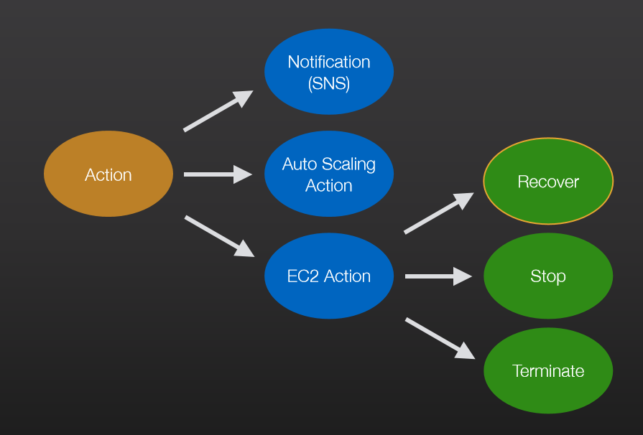
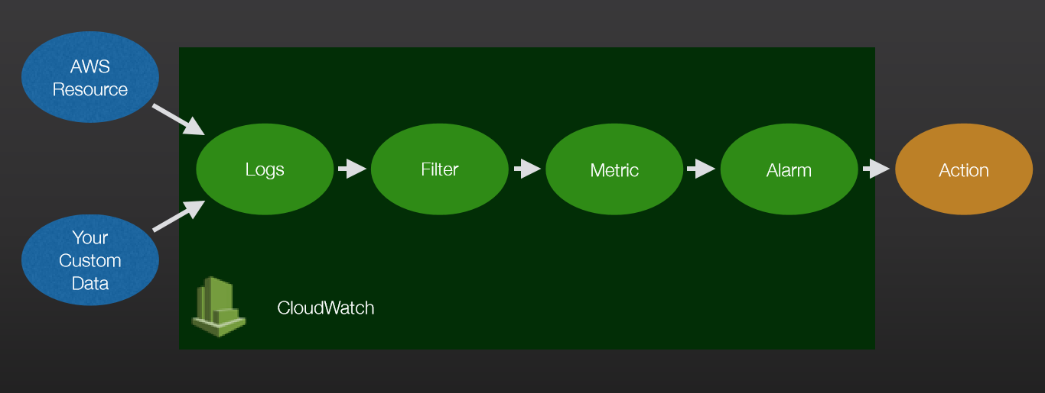
Maintainable
How? Using Amazon Cloud Watch

Slide 22
Cost
On-Demand, Reserved and Spot Instances
Reserved Instances – provides significant discount (up to 75%) compared to On-Demand Instance pricing
Assigned to a specific Availability Zone and provide a capacity reservation.
can provide significant savings compared to the current computing costs.

Slide 23


